Slide 1
Android Component

Slide 2
Beginer
Activity
Intent
Views and View Group
Style – Theme
RecyclerView

Slide 3
Activity
Is a component related to users. Activity handles which window will be displayed in the interface. Activities have their own life cycle starting from onCreate to onDestroy.

Slide 4
Intent
Communication between components in an application is something that is very often done. This is the role of an intent. Some of the functions of intents are that they can be used to run an activity, send messages to broadcast receivers, and can also be used to communicate with running services.

Slide 5
Views & View Group
Basically, all elements between users in an Android application are built using two core components, namely view and viewgroup. A view is an object that draws a display component onto the screen which the user can view and interact directly with.

Slide 6
RecyclerView
The RecyclerView is a more sophisticated display component (widget) than its predecessor Listview. It is more flexible. RecyclerView has the ability to efficiently display large amounts of data. This is especially true if you have a data collection with elements that can vary at runtime.

Slide 7
Medium
- Fragment
Navigation Component
Broadcast Receiver
Rest API & Networking

Slide 8
Fragment
Fragments are one part of the User Interface apart from Activities. The shape is almost the same as Activity, where it has classes for logic code and XML views

Slide 9
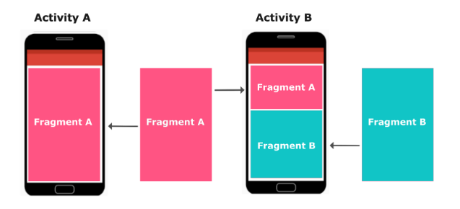
Fragment

Slide 10
Navigation Component
Navigation is a new component included in the Jetpack package. This component has the main function of navigating between Activities and Fragments in an application. The difference is, navigation makes it much easier

Slide 11
Localization
Localization is an effort to localize content and resources in an application so that it can adapt to cultural needs and developments in many countries that are the target market for the application.

Slide 12
Rest API
Web API (Application Programming Interface) is a service that allows two applications to be connected via a network, so that we can retrieve and send data to the service easily.

Slide 13
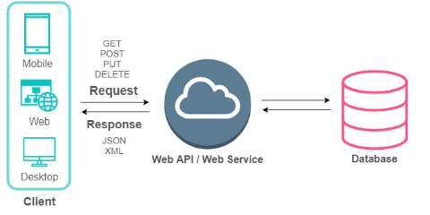
Rest API

Slide 14
Sumber: Dicoding Indonesia
Thank You

